Slide 1

Resilient Digital Education
in Disrupted Environments
FOSS 2026
THE CCDS APPROACH
An offline and hybrid Curriculum Content Delivery System for maintaining learning continuity beyond connectivity and conventional school infrastructure.
Victor Ebirim
Fuzion Mobile Technologies (FMT)
The Gambia
From KLACIFY in Nigeria → iLearn Gambia in The Gambia → a research and collaboration agenda for Continuity-by-Design
Research • Architecture • Collaboration

Slide 2
CONTEXT
The problem: digital learning often assumes connectivity
When connectivity fails, continuity can fail with it.
1
Connectivity gap
2
Infrastructure gap
3
Continuity gap
Internet access may be uneven, costly or unavailable - especially in rural and disrupted environments.
Learners may lack reliable devices, power, platforms or conventional school access.
Content can exist online, yet learners still need a dependable route to the curriculum when systems are interrupted.
The design question
Not simply: “Is the learner online?”
But: “Can the learner still reach the curriculum?”
Victor Ebirim | Fuzion Mobile Technologies | The Gambia | FOSS 2026
2

Slide 3
MATERIALS & METHODS
A different design principle
Continuity-by-Design starts with the curriculum, not the connection.
CONNECTIVITY SHOULD ACCELERATE DIGITAL EDUCATION - NOT DETERMINE WHETHER IT IS POSSIBLE.
1
2
3
4
CURRICULUM
CONTENT
DELIVERY
LEARNING
Design around the learning workflow • package for multiple delivery conditions • synchronize when connectivity returns
Victor Ebirim | Fuzion Mobile Technologies | The Gambia | FOSS 2026
3

Slide 4
MATERIALS & METHODS
What CCDS is - and what it is not
A researchable architecture and implementation approach, not a single application.
CCDS
Curriculum Content Delivery System
NOT A CLAIM
1
Curriculum Content
Content is structured around curriculum, grade, learning sequence and learning objects.
CCDS is not presented here as “one algorithm” or as a claim that every component is open source.
2
Offline-capable
Curriculum resources can be packaged for local use without continuous internet access.
3
Hybrid
Online and offline delivery are connected through controlled updating and synchronization.
RESEARCH OPPORTUNITY
Formalize the architecture, identify the algorithmic components, test interoperability, and document the tools and methods that make continuity-by-design practical.
4
Implementation-neutral
The architecture can be adapted to institutions, programmes, devices and infrastructure conditions.
Victor Ebirim | Fuzion Mobile Technologies | The Gambia | FOSS 2026
4

Slide 5
MATERIALS & METHODS
From KLACIFY to iLearn Gambia: an evolving implementation journey
The architecture is being presented as a platform for research, adaptation and collaboration.
NIGERIA
ARCHITECTURE
THE GAMBIA
NEXT PHASE
KLACIFY
CCDS
iLearn Gambia
Research + Scale
CCDS concept initiated and developed in an earlier implementation context.
Curriculum content, offline-capable and hybrid delivery principles are articulated.
The approach is implemented in an online/offline education context.
Formalize tools, algorithms, evidence and partnerships for wider adoption.
The objective now is not only implementation - it is to make the architecture researchable, improvable, transferable and scalable.
Victor Ebirim | Fuzion Mobile Technologies | The Gambia | FOSS 2026
5

Slide 6
MATERIALS & METHODS
CCDS architecture: curriculum → content → delivery → continuity
A layered view separates what is taught from how it is packaged, delivered and improved.
1 CURRICULUM MODEL
Grades • subjects • learning sequence • competencies
2 CONTENT LAYER
Lessons • e-books • multimedia • quizzes • assessments
3 PACKAGING & DELIVERY
Online platform • offline package • device/SD-card delivery
4 LEARNER / TEACHER LAYER
Access • practice • facilitation • assessment • support
5 SYNCHRONIZATION & MANAGEMENT
Updates • progress • monitoring • administration • analytics
Architecture question for research: which components are rules, which are algorithms, which are data structures, and which are implementation tools?
Victor Ebirim | Fuzion Mobile Technologies | The Gambia | FOSS 2026
6

Slide 7
How CCDS is implemented and used
MATERIALS & METHODS
A practical process from curriculum definition to learner use and continuous improvement.
1
MAP
2
STRUCTURE
3
PACKAGE
Define curriculum structure and learning outcomes
Create reusable curriculum-aligned content objects
Prepare online and/or controlled offline delivery packages
4
DEPLOY
5
USE
6
SYNC + IMPROVE
Place content in the learner/teacher delivery environment
Learners learn; teachers facilitate, assess and support
Synchronize updates and records when connected; monitor and refine
Victor Ebirim | Fuzion Mobile Technologies | The Gambia | FOSS 2026
7

Slide 8
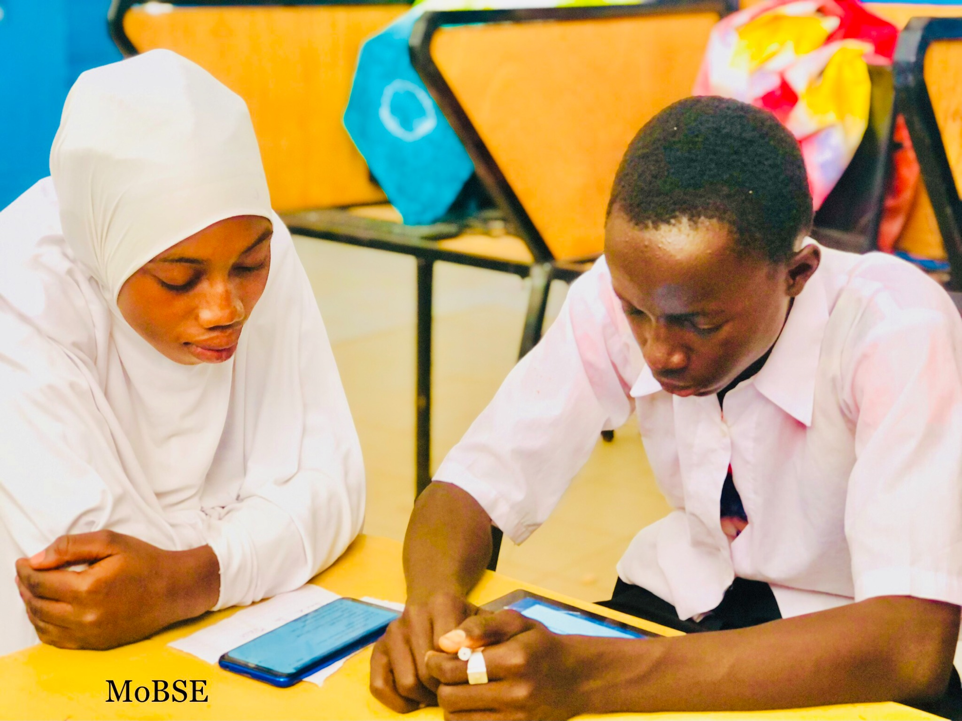
RESULTS
Implementation context: iLearn Gambia
A practical online/offline implementation in The Gambia.
A
Online + offline learning
The implementation provides structured digital learning while preserving access where connectivity is intermittent or unavailable.
B
Portable curriculum delivery
Offline content packages extend the same learning architecture into local learner/device environments.
C
Three active roles
Learner accesses; teacher facilitates; system updates, monitors and synchronizes when connected.
iLearn Gambia • classroom / learner context
Victor Ebirim | Fuzion Mobile Technologies | The Gambia | FOSS 2026
8

Slide 9
RESULTS
What the implementation makes visible
The result is not “offline access” alone - it is a continuity mechanism.
Continuity
Equity
Learning resources can remain reachable through weak networks, outages or temporary disruption.
Reduced dependence on continuous home connectivity and recurring data access.
Teacher agency
Scalability
Teachers retain structured curriculum resources and learning workflows even when the network is unavailable.
The same content architecture can support online, offline and hybrid programmes across different infrastructure conditions.
Evidence boundary: this presentation describes an implementation architecture and operational context; it does not claim controlled causal learning effects.
Victor Ebirim | Fuzion Mobile Technologies | The Gambia | FOSS 2026
9

Slide 10
DISCUSSION
What can be publicly researched, improved and shared?
A collaboration surface can be defined without disclosing proprietary implementation details.
Design language
Architecture
Algorithmic questions
Research tools
Curriculum-centric architecture; layered delivery; offline-first; hybrid synchronization; continuity-by-design.
Content objects, packaging, delivery modes, synchronization pathways, roles and interoperability boundaries.
Content selection; packaging logic; synchronization rules; update resolution; analytics and adaptation.
Open technologies, standards, testing methods, repositories and reproducible evaluation approaches.
Boundary for collaboration
Share the architecture, design principles, research questions and reproducible methods where appropriate. Keep proprietary source code, credentials, sensitive configurations and protected implementation details outside the public research layer.
Victor Ebirim | Fuzion Mobile Technologies | The Gambia | FOSS 2026
10

Slide 11
DISCUSSION
Research agenda: formalize the technical core
A second paper is underway to document the tools and methods employed in designing the CCDS architecture.
ALGORITHMIC RESEARCH
SECOND PAPER UNDERWAY
1
Content mapping
How curriculum structures become reusable digital learning objects.
Tools employed in the design of CCDS architecture
2
Packaging logic
How content is selected, versioned and assembled for offline delivery.
The paper will bring the technical design layer into clearer view: the tools, standards, software components, development methods and architectural choices used to construct and evolve CCDS.
3
Synchronization
How updates and learning records move between connected and disconnected states.
4
Adaptation
How future intelligent services can personalize without making connectivity mandatory.
Goal: make the architecture more researchable, testable and transferable.
Victor Ebirim | Fuzion Mobile Technologies | The Gambia | FOSS 2026
11

Slide 12
DISCUSSION
AI belongs as an intelligence layer - not the continuity foundation
The resilience principle should survive even when cloud AI or internet services are unavailable.
AI / INTELLIGENCE LAYER
CCDS • ONLINE + OFFLINE DELIVERY
CURRICULUM + STRUCTURED CONTENT
Learner assistance
Teacher support
Analytics
Support and guidance when services are available.
Adaptation, feedback and resource assistance.
Insights and early identification of learning needs.
Victor Ebirim | Fuzion Mobile Technologies | The Gambia | FOSS 2026
12

Slide 13
DISCUSSION
The invitation: build Continuity-by-Design together
The next step is collaboration - not a finished claim.
CCDS is presented here as a working architecture and research proposition that can be improved through wider technical and academic participation.
ALGORITHM DEVELOPERS
FOSS / EDTECH RESEARCHERS
UNIVERSITIES & RESEARCH CENTRES
DEVELOPMENT PARTNERS
Formalize and test synchronization, packaging, mapping and adaptation logic.
Study interoperability, standards, reproducibility and open implementation pathways.
Evaluate the architecture, document evidence and conduct comparative studies.
Support adaptation, adoption, scale and continuity-by-design in real programmes.
RESEARCH → VALIDATE → IMPROVE → ADAPT → ADOPT → SCALE
Victor Ebirim | Fuzion Mobile Technologies | The Gambia | FOSS 2026
13

Slide 14
DISCUSSION
Conclusion: design for continuity, then scale the architecture
A resilient digital education system does not ask only whether a learner is online.
It asks whether the learner can still reach the curriculum.
DESIGN FOR DISRUPTION
PROTECT CONTINUITY
SCALE THE ARCHITECTURE
Treat outages, device limitations and school interruption as design conditions.
Use online and offline routes so learning can continue while connectivity is restored.
Make the curriculum delivery layer adaptable to future intelligent services and new contexts.
Connectivity should accelerate digital education — not determine whether digital education is possible.
Victor Ebirim | Fuzion Mobile Technologies | The Gambia | FOSS 2026
14

Slide 15
Questions & Discussion
Resilient Digital Education in Disrupted Environments: The CCDS Approach
Research • Algorithms • Tools • Continuity-by-Design • Collaboration • Scale
Victor Ebirim
Fuzion Mobile Technologies (FMT) • The Gambia
FOSS 2026 | October 2026

